Slide 1
Online Learning System for Python Scrapper
– Team 6 –
김상민, 김제현, 김호연, 박휘찬, 신동휘, 이지섭,

Slide 2
Contents
Backend
Frontend
IDE
Deployment

Slide 3
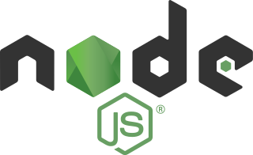
Backend – Node.js
Server configured with express module
Communicates with MySQL DBMS using sequelize module

Slide 4

Backend – MySQL
Database table structure
User
id (PK): bigint, email: string, password: string
Tutorial
id (PK): bigint, chapter: string, title: string, content: string
Problem
id (PK): bigint, chapter: string, problem: string, answer: string
UserProblemSet
id (PK): bigint, user (user.id), problem (problem.id), is_solved: enum [“Y”, “N”]

Slide 5


Frontend
Based on Next.js and React
Provides web page component structures
Such as log-in page and problem pages
Communicates with backend to fetch contents with API

Slide 6
How to communicate Front & Backend
React
Web Cilent
Backend nodejs express provide api router with DB manager
Frontend can request GET or POST method with that url like /api/auth/login
If request income, backend response with some data to frontend client
This makes development pallely
Request
Response
Nodejs
sequelize
data
Mysql

Slide 7
IDE
React
CodeMirror
CodeMirror-based Python IDE
Python:3.10 Docker container
User-submitted codes run on this
If user click run or submit button, code and input will send to server
/api/runcode will execute a code
Result returned and shown in web page
Request
Response
Nodejs
Code, input
Output
Python3
Container
(volatility)

Slide 8
IDE
(modified) Using nodejs Python-shell for code executing ➔ secure issue, server attack, access to other user’s code… ➔ Virtualizing with Docker container
(added) Timeout 10 sec, Long output denied
(fixed) Post request to server with code
(fixed) Code-Mirror IDE design
(fixed) run with input, grading correct answers
(fixed) Code save and load for user

Slide 9
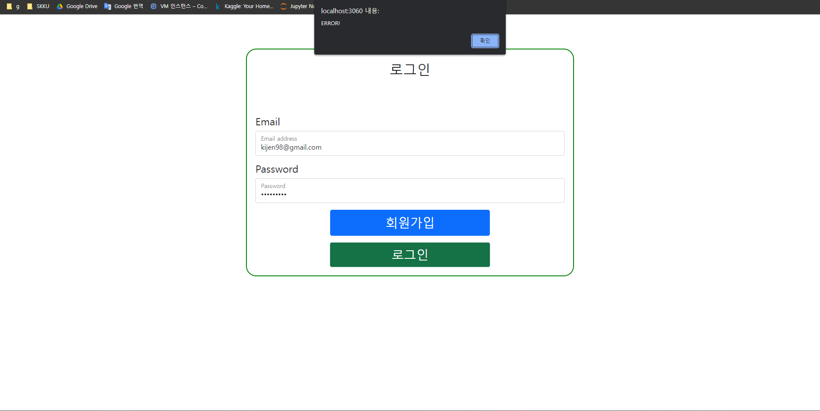
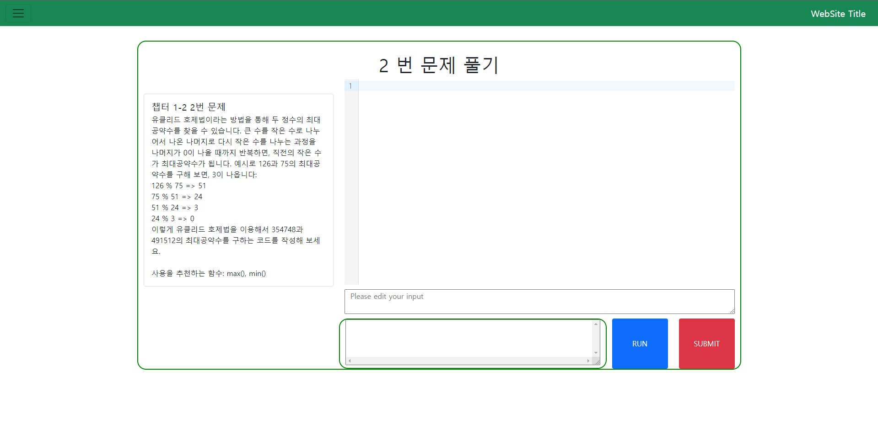
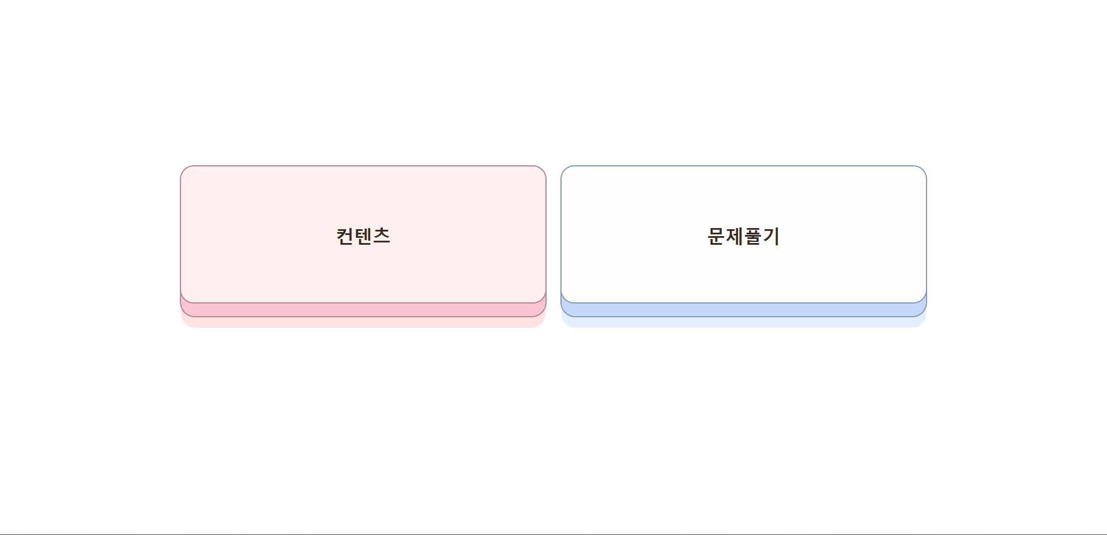
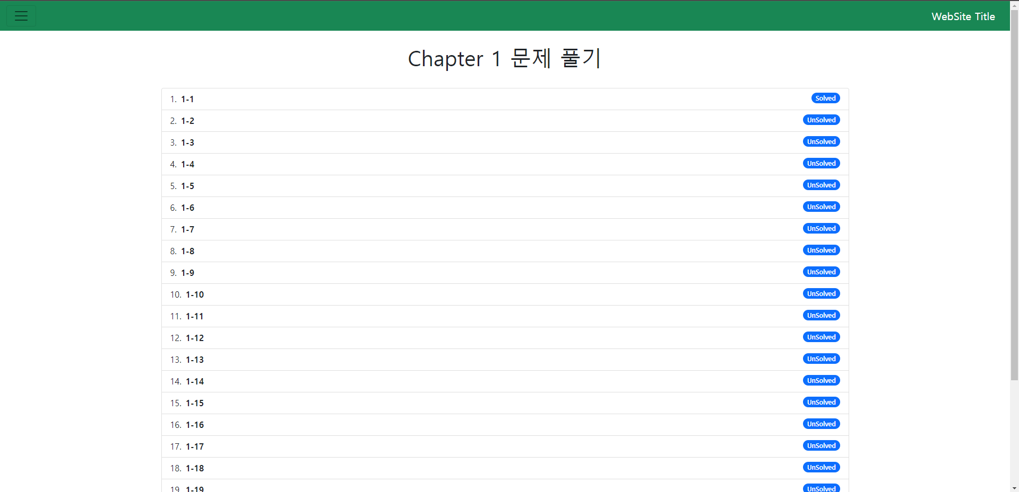
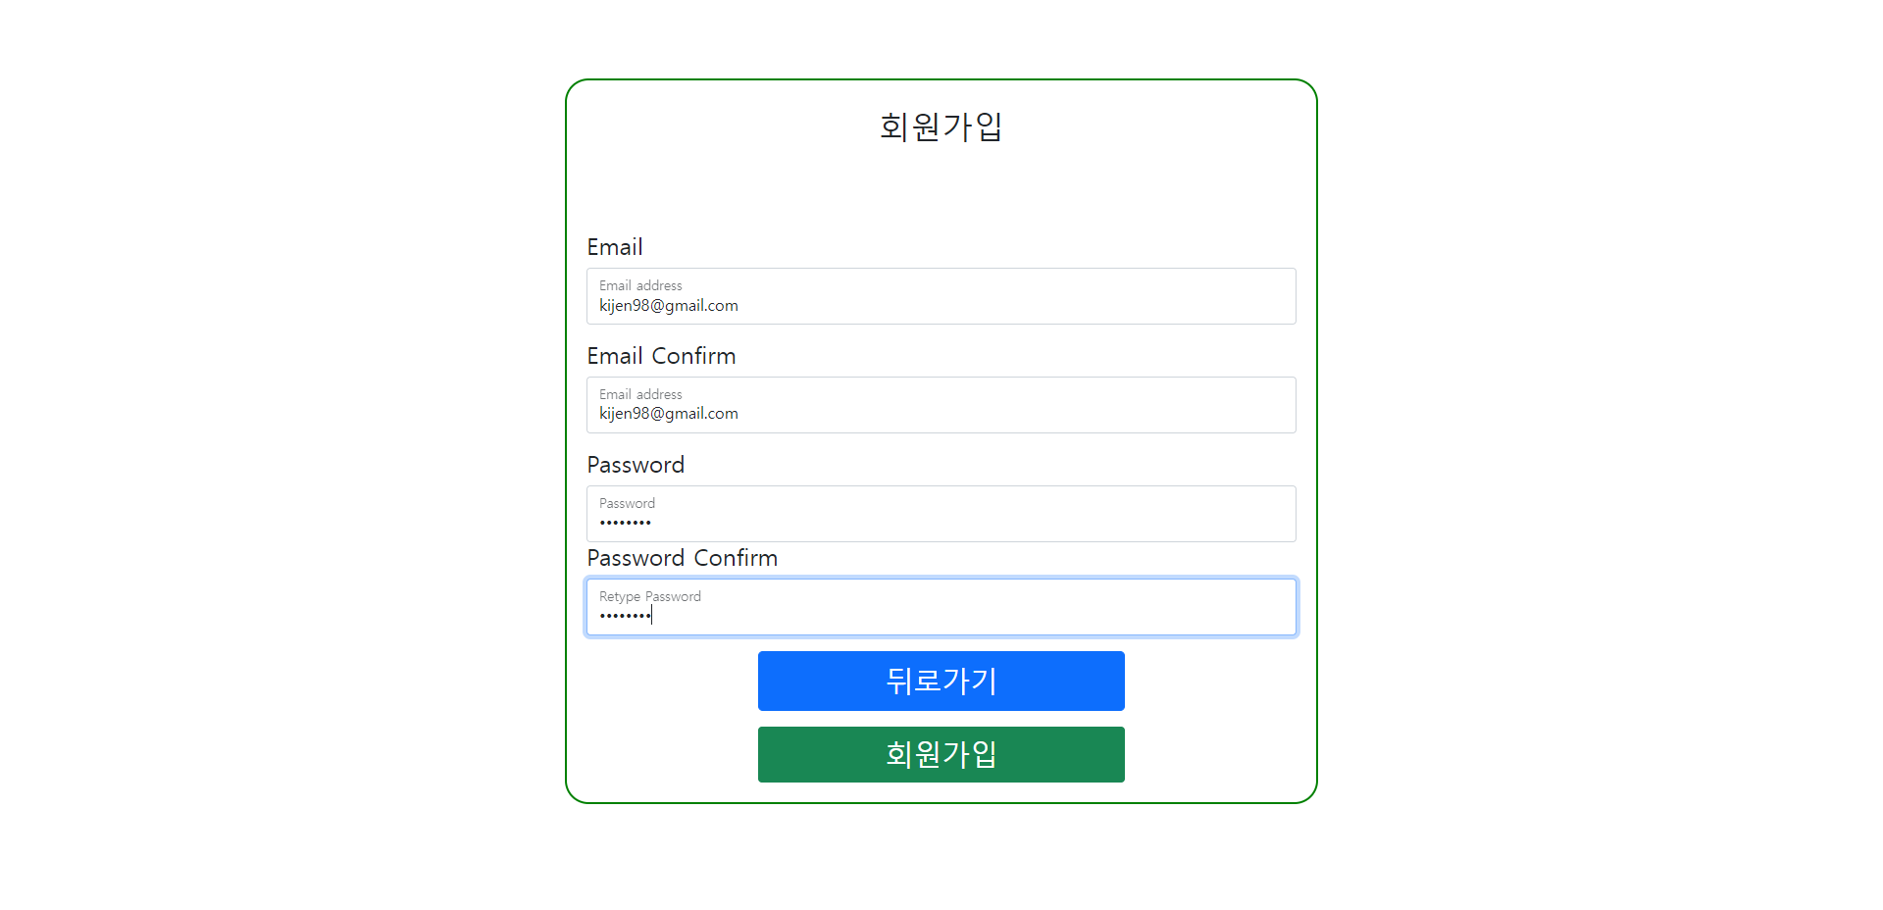
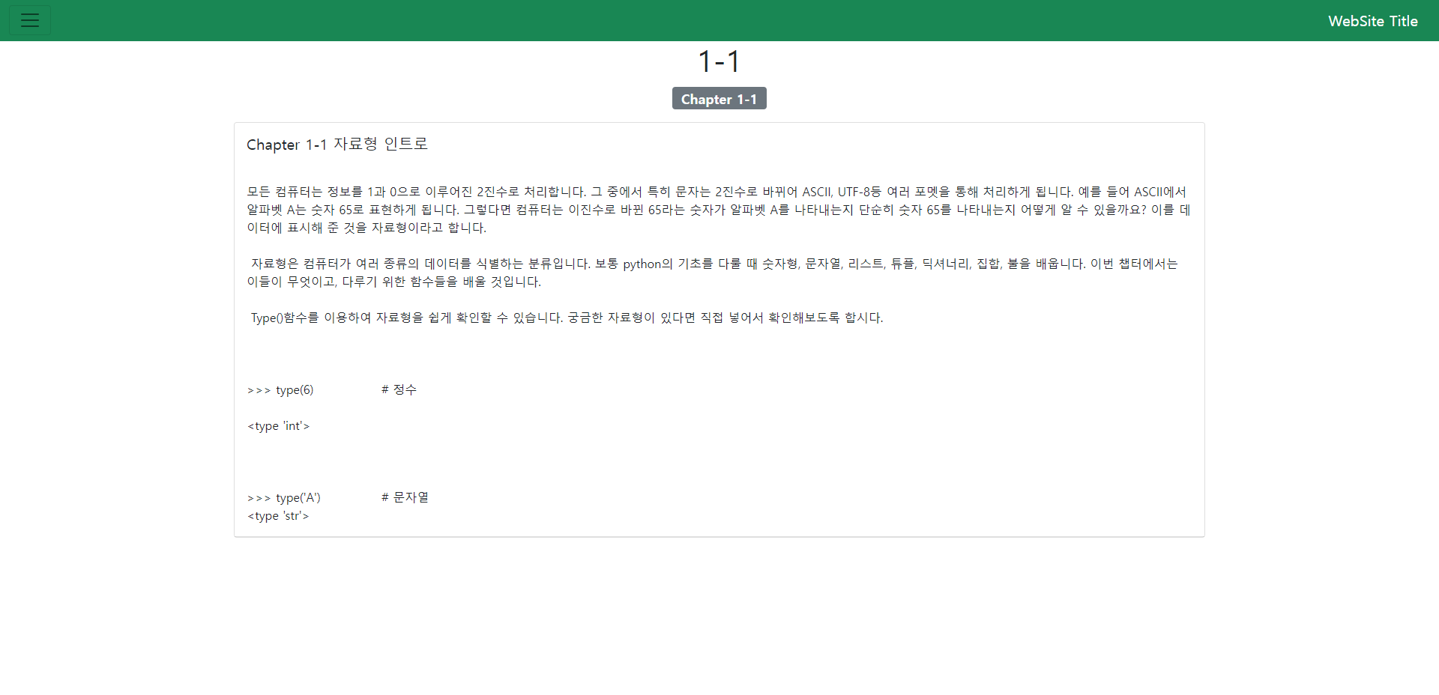
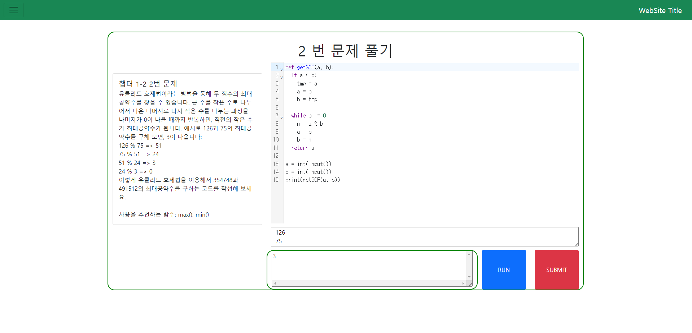
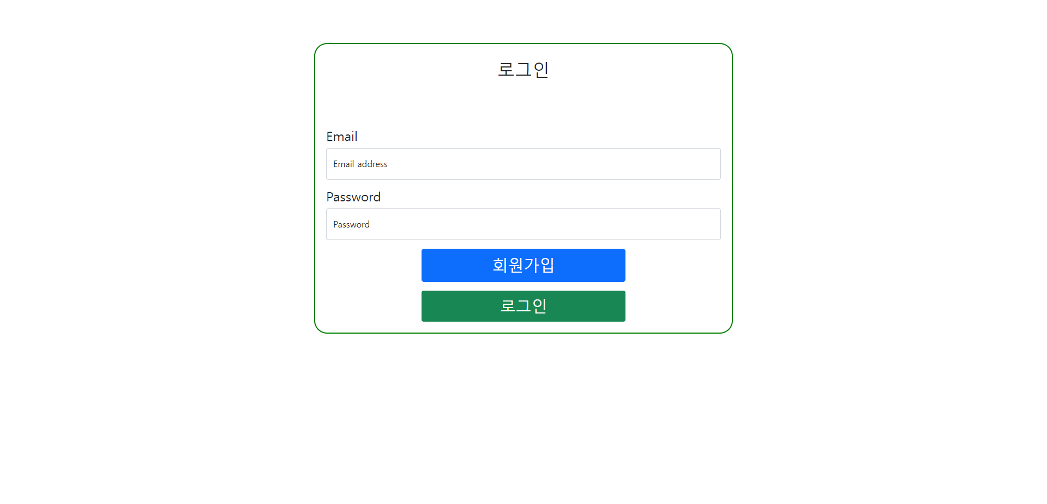
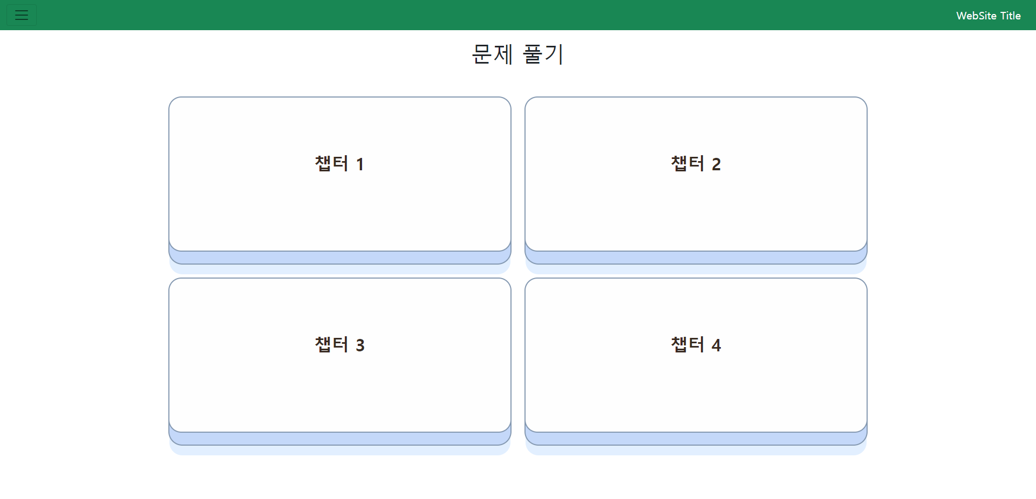

Slide 10
Container deployment
Dependency and Docker containers maintained by two shell scripts run.sh and stop.sh
node:18, mysql:8, and python:3.10 container executed by docker
Python container is volatile alive, when code should be executed
Nodejs
Container
Mysql
Container
Python3
Container
(volatility)

Slide 11
server Environment
Deployed and tested on a personal NAS-Synology

